Slide 1

Real-time collaboration platform
Rehan Rasool ‘15, Omar Waheed ‘15, Ronak Shah ‘17

Slide 2
What is Chimpad?
a collaboration platform for people especially developers
Enables them to create files to collaborate together in real-time
Think of it as Google Docs for developers

Slide 3
Why Chimpad?
Name
Chimpanzees Have Better Memory Than Humans
Features
Real-time document
Real-time messaging
Sharing / Collaborators
Public or Private
Free

Slide 4
DEMO
Sign up
Login
Create a Pad (Public)
Add Collaborator
Open Collaborator in incognito
Collaborate
Syntax Highlighting
Messaging
Find Pads
Code
LeanKit

Slide 5
Technologies
Front-end (Client-side)
HTML5
CSS (Bootstrap)
Jquery
Back-end (Server-side)
NodeJS
Socket
Express
Session
Database
PostgreSQL
App Engine
Heroku
Version control
Git
Syntax Highlighting
ACE
Time
Moment JS
Development
LeanKit

Slide 6
Requirements Analysis
Database needs
Users
Pads
Messages
Languages

Slide 7
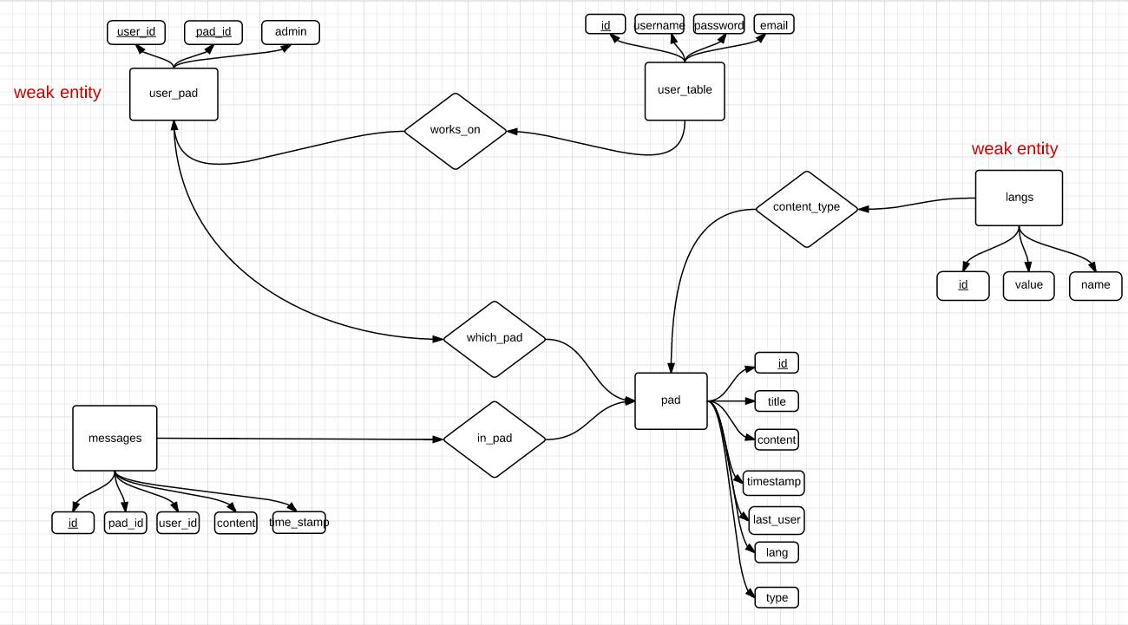
ER Diagram

Slide 8
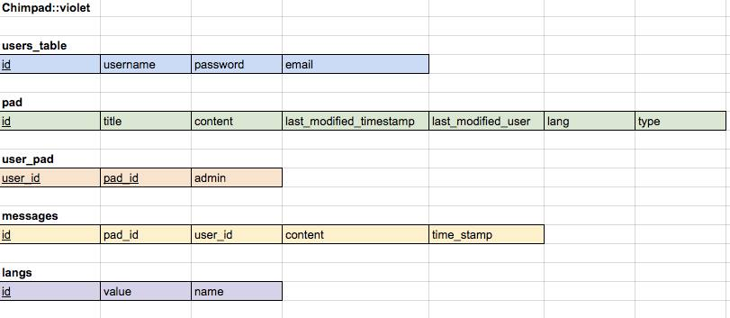
Schema

Slide 9
Lessons
NodeJS Stack is complicated at first but easy later
Efficient and scalable
PostgreSQL does things a little differently

Slide 10
Future
Add more languages
Add revision history
Add search by timestamp to pad and messages

Slide 11
Links
chimpad.herokuapp.com
github.com/rehanrasool/chimpad

Slide 12
Questions?

Slide 13
Thank You

